Slide 1
Some Preliminary Transfer Learning Results for Dynamical Systems
Joshua Hammond, Brian Korgel, Michael Baldea
McKetta Department of Chemical Engineering
The University of Texas at Austin
Acknowledgments: Tyler Soderstrom, ExxonMobil
TWCCC Fall Meeting 2025
Notes:
Thanks. As mentioned, my name is Joshua Hammond. I’m entering the 5th year of my PhD at the University of Texas with Dr. Baldea.
As I begin, I want to thank Tyler Soderstrom from ExxonMobil for both the financial support, and the collaboration, over the last almost two years

Slide 2

Chemical Processes are “Copies” of Dynamical Systems
Several plants are built off the same blueprint
Similar but not identical
May use a module (or more) in multiple designs
How can *data driven* modeling knowledge developed for one system be leveraged in the operation and control of another “copy”
>> Transfer learning
M. Baldea, T.F. Edgar, B. Stanley, A.A. Kiss, Modular Manufacturing: Status, Challenges and Opportunities, AIChE Journal, 63(10), 4262-4272, 2017
Notes:
We’re motivated by the application of data-driven dynamical models of chemical processes for next-step prediction. This becomes challenging as even processes that are designed identically do not behave identically. In the same way that there is always some element of plant-model mismatch, you could say that there is an element of plant-plant mismatch as well.
Since each system is unique, an accurate data-driven model would need to be derived from measurements from that specific system to capture the unique bahavior. However, creating bespoke models of each system is a laborious effort and may not be practical due to the volume of data available from that specific system.
Our goal is to use transfer learning to adapt an existing model to a sister system with the goal of less effort spent in model-building, and the ability to model the system more accurately with less data.
The key takeaway that I will present here is that small changes in existing NN model parameters can adapt the model from the original source system to the new target system.

Slide 3
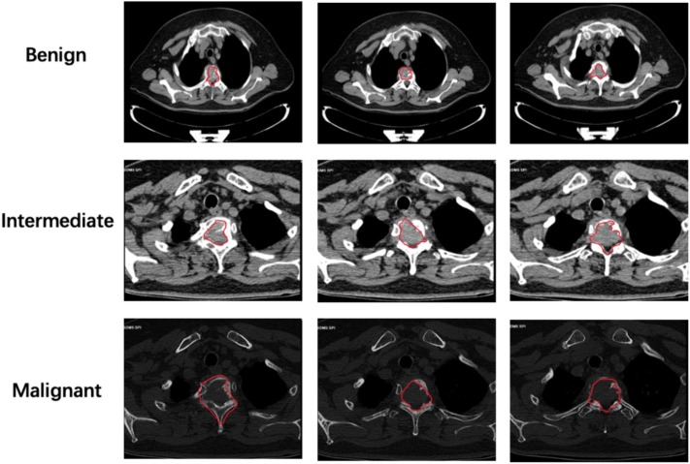
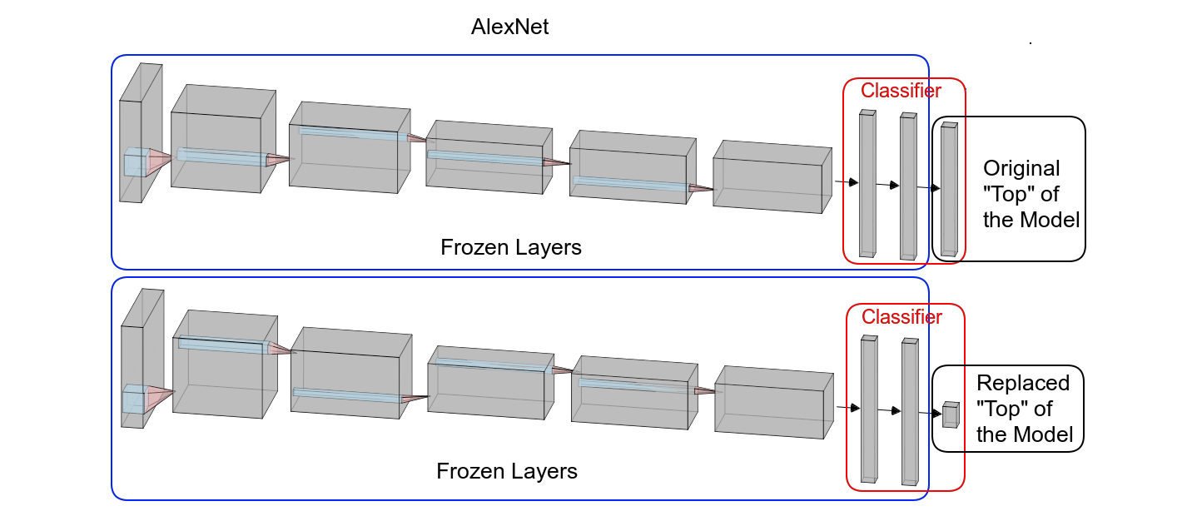
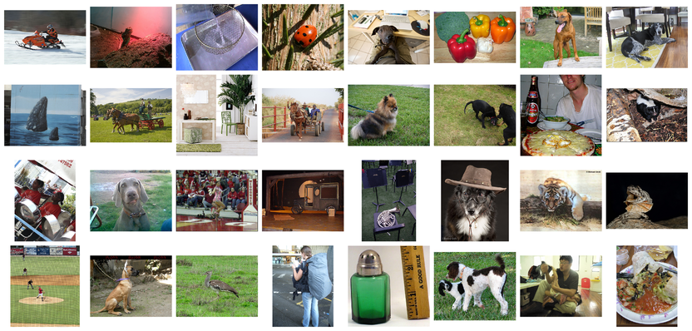
Most existing TL applications focus on image classification
Source: ImageNet Classification^{[1]}
Image classification from 1,000 common objects
Target: Medical Diagnositics^{[2]}
Classification of tumor type
Not dynamical systems – no governing equation constraints
[1] Russakovsky et. Al. “ImageNet Large Scale Visual Recognition Challenge” arXiv: 1409.0575 [2] Guo et. Al. “Radiographic imaging and diagnosis of spinal bone tumors: AlexNet and ResNet for the classification of tumor malignancy” 2024 Journal of Bone Oncology [3]AlexNet Visualization: Daniel Voight Godoy https://github.com/dvgodoy/dl-visuals/
Notes:
Canonically, transfer learning has been applied in image processing. For example, the model known as AlexNet model was originally trained to perform image classification on the ImageNet dataset. Subseqent work used transfer learning to adapt the AlexNet to perform tumor classification using medical diagnostic imagery.
*click*
The Transfer Learning process generally involves freezing the initial layers of the NN and only training the last few layers.
The intuition is that the lower-level layers of the NN learn to extract features from the images while the later layers learn the combination of those features that correspond to various classifications. If the source model was trained well, and the data are similar enough, the features extracted by the source model should be similarly useful for the target classification task.
In addition, transfer learning is useful when there is limited data available from the system of interest. In these cases, limiting the number of parameters that are trained by only retraining the last few layers prevents overfitting with the limited amount of training data.
Transfer learning works well in the case of using AlexNet for tumor classification for a few reasons:
the source model was trained on a large volume of data,
the tasks of the source model and target model are both image classification
and the target dataset has fewer examples by nature of it's content so there is likely not enough data to retrain the model. Instead, adapting the features extracted by AlexNet makes the most sense given the limited data available.
While the approach of only updating the later layers of the model works well for image classification, it may not necessarily extend to models of dynamical systems.
Our goal is to have a more-principled method for determining which NN parameters are modified when performing transfer learning on models of dynamical systems.
--- supplemental info ---
AlexNet:
60 million parameters
One of the key advances was training over two days on two 3GB graphics cards, splitting the model across the cards

Slide 4
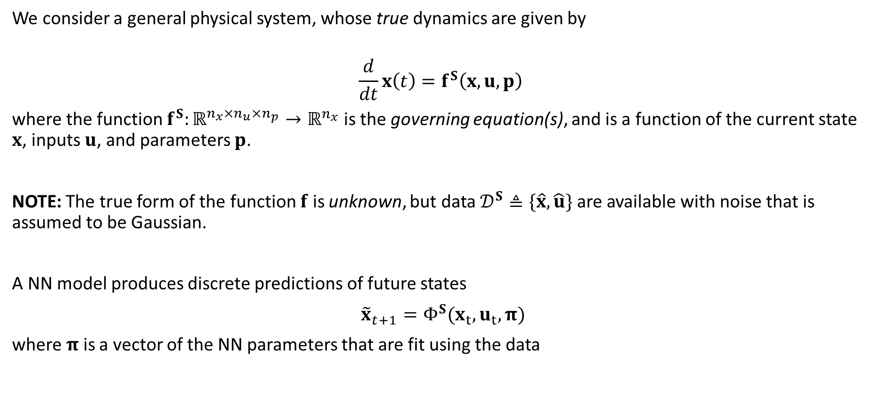
Machine learning models of dynamical systems
We consider a general physical system, whose true dynamics are given by
$$\frac{d}{dt}x\left(t\right)=f^{S}\left(x,u,p\right)$$
where the function $f^{S}:ℝ^{n_{x}×n_{u}×n_{p}}→ℝ^{n_{x}}$ is the governing equation(s), and is a function of the current state $x$, inputs $u$, and parameters $p$.
NOTE: The true form of the function $f$ is unknown, but data $𝒟^{S}≜\{\hat{x},\hat{u}\}$are available with noise that is assumed to be Gaussian.
A NN model produces discrete predictions of future states
${\tilde{x}}_{t+1}=Φ^{S}(x_{t},u_{t},π)$
where $π$ is a vector of the NN parameters that are fit using the data
Notes:
We will assume that these dynamical systems are functions of their current states (x), inputs (u) and parameters (p). A discrete-form NN model of the system (shown by phi) would predict future states using previous state measurements, inputs, and the NN parameters (π)

Slide 5
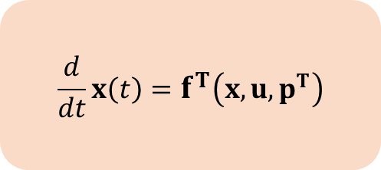
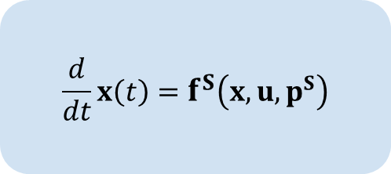
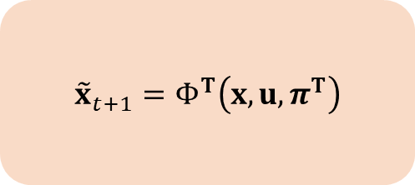
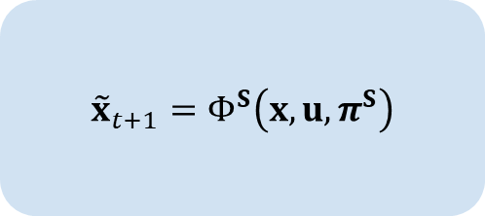
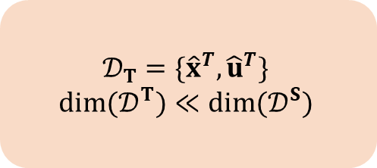
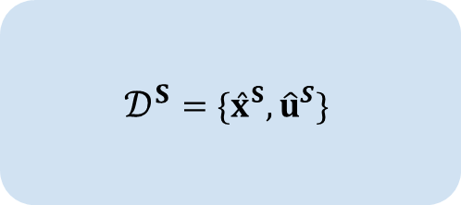
Research Problem Formulation
Source System
Target System
$$\frac{d}{dt}x\left(t\right)=f^{S}\left(x,u,p^{S}\right)$$
$$\frac{d}{dt}x\left(t\right)=f^{T}\left(x,u,p^{T}\right)$$
Assumption: Source and Target systems are similar but not identical
Need: minimize use of Target system data to build a ML model, starting from ML model of Source system
System Space
$$𝒟^{S}=\{{\hat{x}}^{S},{\hat{u}}^{S}\}$$
$$𝒟_{T}=\{{\hat{x}}^{T},{\hat{u}}^{T}\}$$
$$dim⁡(𝒟^{T})≪dim⁡(𝒟^{S})$$
Data Space
$${\tilde{x}}_{t+1}=Φ^{S}\left(x,u,π^{S}\right)$$
$${\tilde{x}}_{t+1}=Φ^{T}\left(x,u,π^{T}\right)$$
Model Space
Notes:
Our problem then becomes how to use the source NN model that was trained with sufficient data, and a much smaller dataset from the target system to accurately model the target system.
We will assume that the systems are similar but not identical.

Slide 6
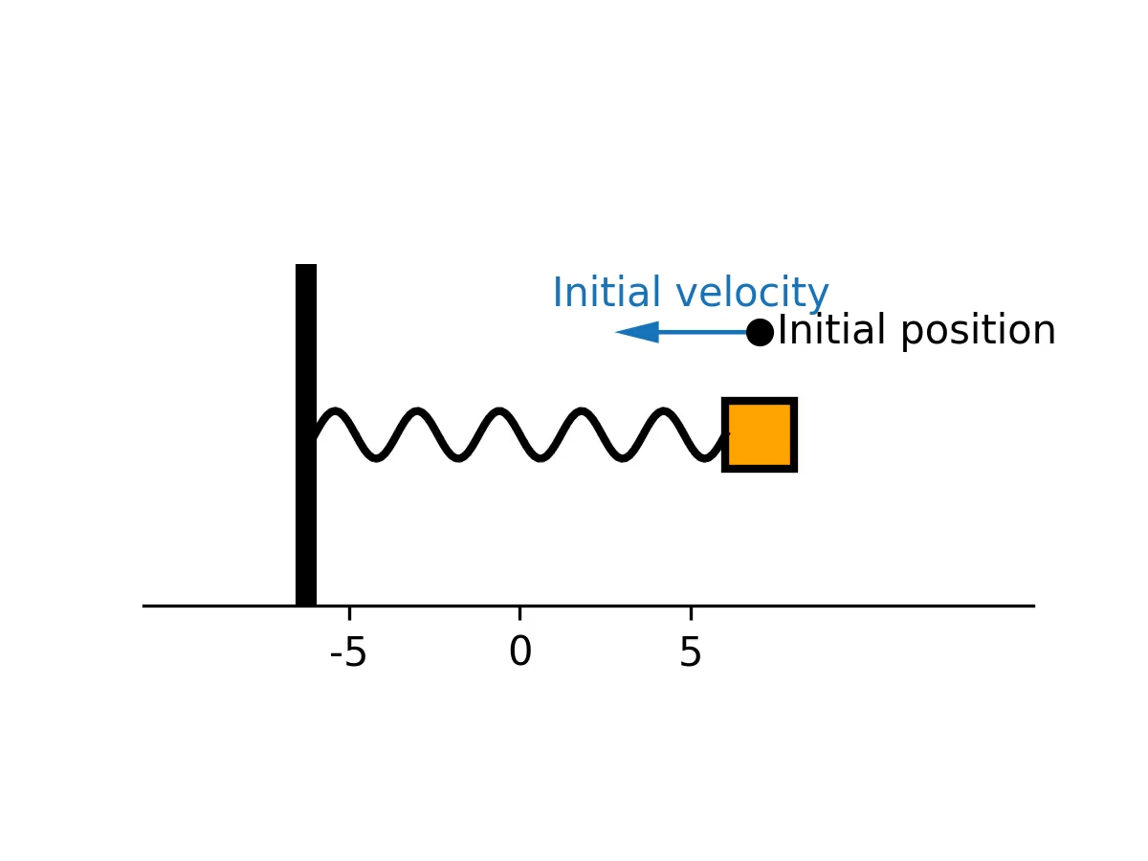
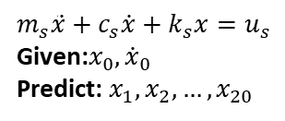
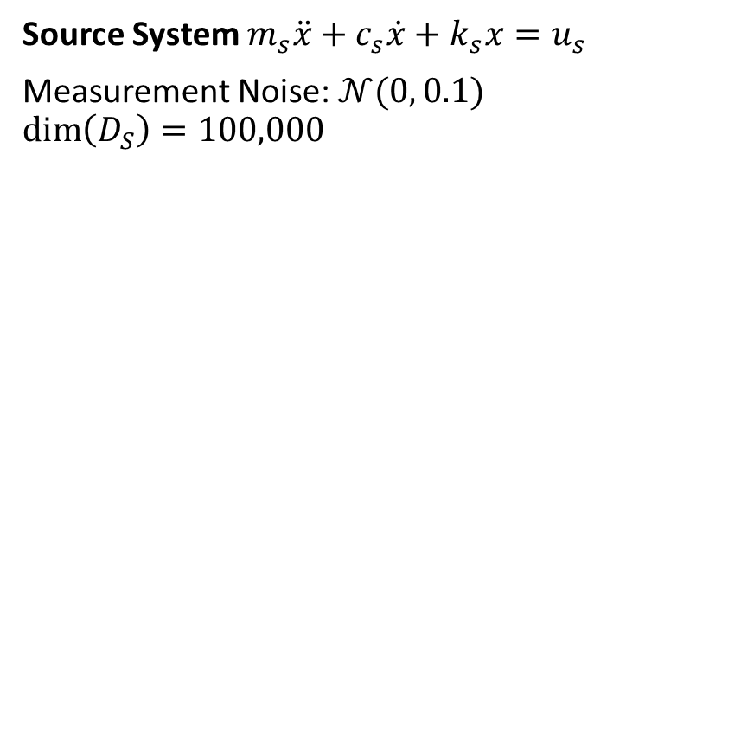
Example: Damped Spring
$$m_{s}\ddot{x}+c_{s}\dot{x}+k_{s}x=u_{s}$$
Given:$x_{0},{\dot{x}}_{0}$
Predict: $x_{1},x_{2},…,x_{20}$
Source System $m_{s}\ddot{x}+c_{s}\dot{x}+k_{s}x=u_{s}$
Measurement Noise: $𝒩(0, 0.1)$
$$\dim\left(D_{S}\right)=100,000$$
Use a 2-layer MLP
32 neurons each layer
Sigmoid activation
2,868 trainable parameters
Notes:
We will discuss our methods performing transfer learning in the context of a simple damped spring system.
*click*
Given initial position and velocity measurements,
*click*
we train a 2-layer perceptron neural network to predict the position over the next 20 timepoints using 100,000 examples.

Slide 7
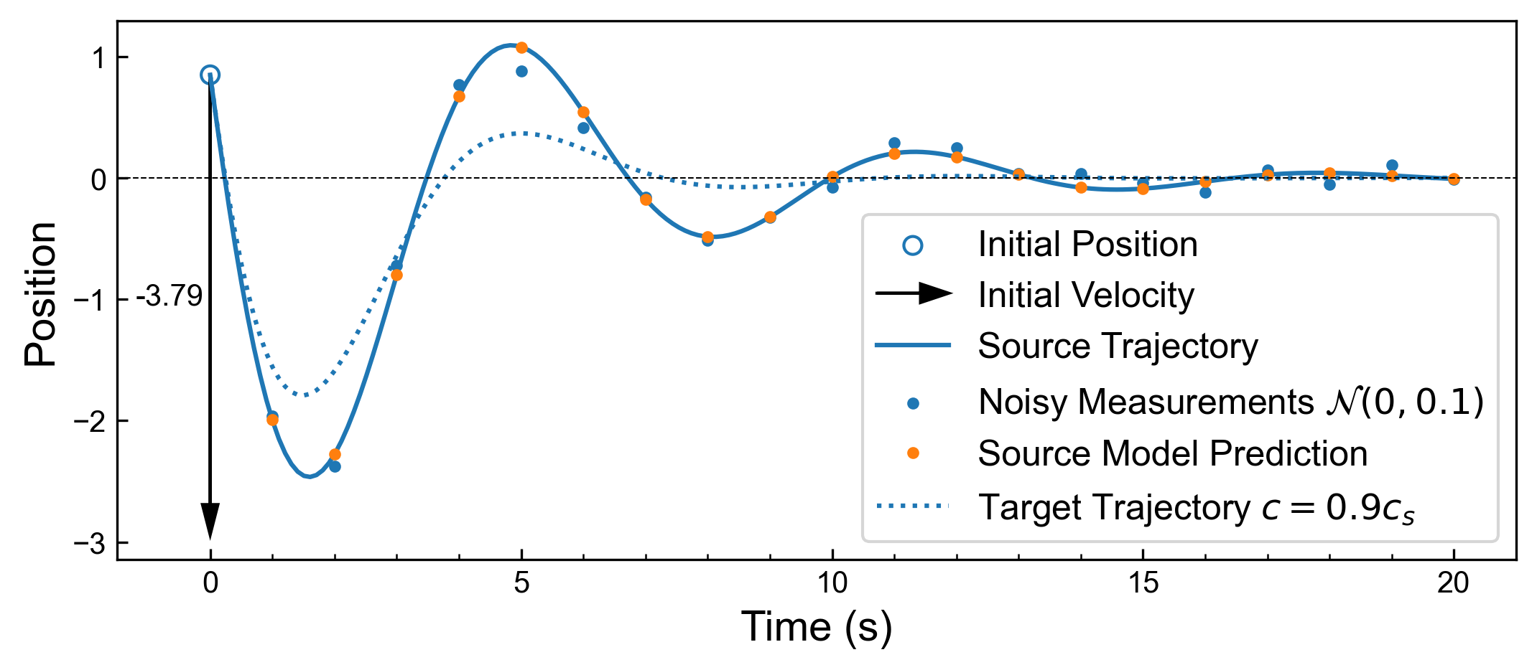
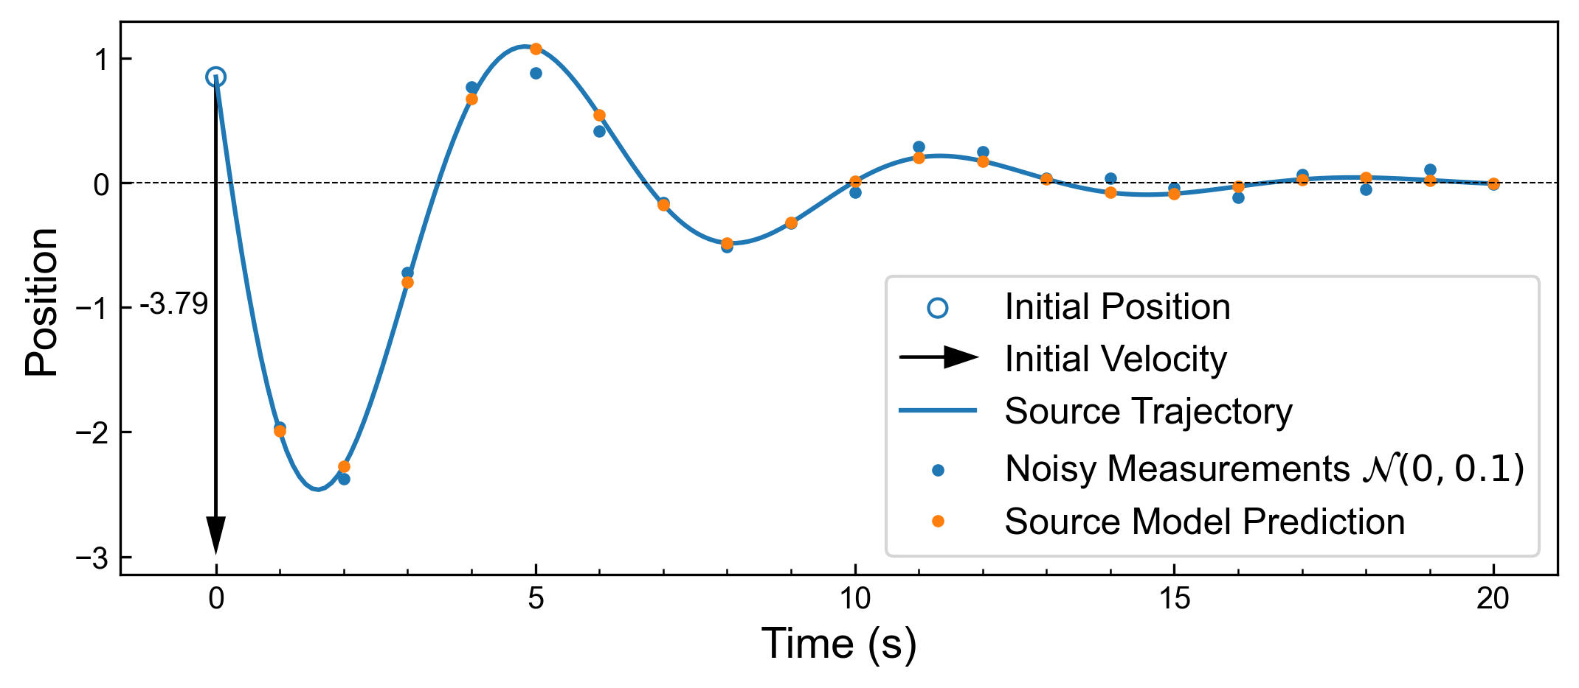
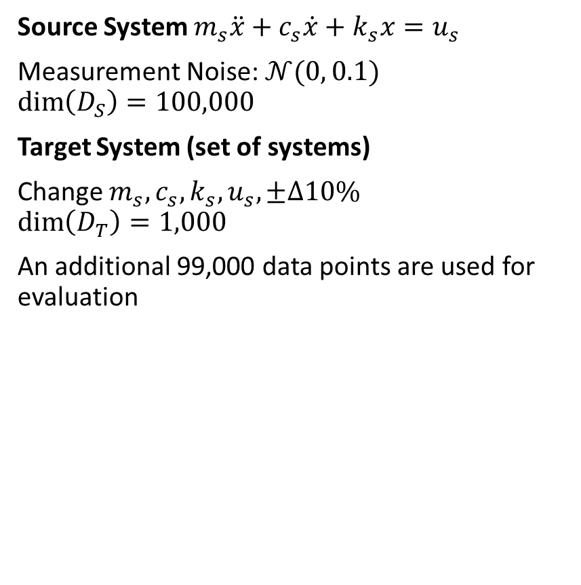
Example: Damped Spring
$$m_{s}\ddot{x}+c_{s}\dot{x}+k_{s}x=u_{s}$$
Given:$x_{0},{\dot{x}}_{0}$
Predict: $x_{1},x_{2},…,x_{20}$
Source System $m_{s}\ddot{x}+c_{s}\dot{x}+k_{s}x=u_{s}$
Measurement Noise: $𝒩(0, 0.1)$
$$\dim\left(D_{S}\right)=100,000$$
Target System (set of systems)
Change $m_{s},c_{s},k_{s},u_{s},±Δ10\%$
$$\dim\left(D_{T}\right)=1,000$$
An additional 99,000 data points are used for evaluation
Use a 2-layer MLP
32 neurons each layer
Sigmoid activation
2,868 trainable parameters
Can the NN model of the Source oscillator be easily adapted to the Target oscillator?
Notes:
The plot on the right shows one of the highest error examples from the validation dataset. Position of the mass at the end of the spring is shown vertically as time progresses left to right with the open circle indicating the initial position and the arrow shows the initial velocity. The solid line shows the underlying continuous function, while blue dots show the discrete noisy measurements. We train the model with only knowledge of the noisy measurements shown by the blue dots. The predictions of the trained model are shown in orange.
*click*
Now we change from the source system to the target system shown in the dashed line on the plot. In this example, the target spring stiffness (c) increases by 10%. The number of examples in the target dataset is also limited to 1% of the examples that were available to the source system.
Given the limited data available from the target system, adapting the model of the source system to the target system may increase our accuracy on unseen data from the target system

Slide 8
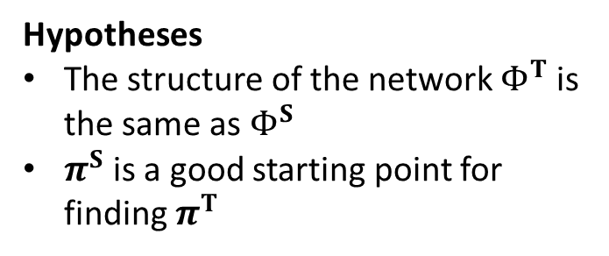
Transfer Learning in Dynamical Systems
Source System
Target System
$$\frac{d}{dt}x\left(t\right)=f^{S}\left(x,u,p^{S}\right)$$
$$\frac{d}{dt}x\left(t\right)=f^{T}\left(x,u,p^{T}\right)$$
Assumption
The two systems are similar but not identical
Quantify similarity
System Space
$$𝒟^{S}=\{{\hat{x}}^{S},{\hat{u}}^{S}\}$$
$$𝒟_{T}=\{{\hat{x}}^{T},{\hat{u}}^{T}\}$$
$$dim⁡(𝒟^{T})≪dim⁡(𝒟^{S})$$
Data Space
$${\tilde{x}}_{t+1}=Φ^{S}\left(x,u,π^{S}\right)$$
$${\tilde{x}}_{t+1}=Φ^{T}\left(x,u,π^{T}\right)$$
Hypotheses
The structure of the network $Φ^{T}$is the same as${ Φ}^{S}$
$π^{S}$is a good starting point for finding $π^{T}$
Model Space
Notes:
If we call back to our research problem, we need to quantify the similarity of the two systems being modeled--we would hope the systems contain mutual information and that transfer learning benefits us compared to retraining the model
Then, we hypothesize that the structure of the models will be the same, and that the NN parameters of the source model are a good starting point for finding the parameters of the target system

Slide 9
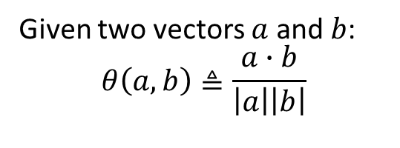
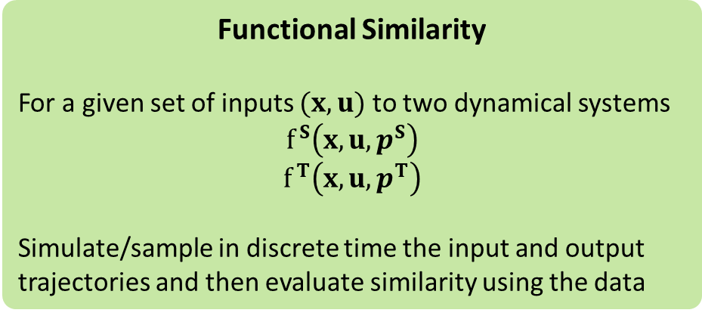
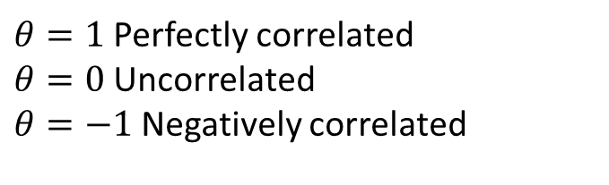
Cosine Similarity
Given two vectors $a$ and $b$:
$$θ\left(a,b\right)≜\frac{a∙b}{\left|a\right|\left|b\right|}$$
Some benefits:
Scale, translation independent
Robust to different lengths, high dimensionality
Interpretability
$θ=1$ Perfectly correlated
$θ=0$ Uncorrelated
$θ=−1$ Negatively correlated
Data Similarity
Done on a variable by variable basis
Functional Similarity
For a given set of inputs $(x,u)$ to two dynamical systems
$$f^{S}\left(x,u,p^{S}\right)$$
$$f^{T}\left(x,u,p^{T}\right)$$
Simulate/sample in discrete time the input and output trajectories and then evaluate similarity using the data
Notes:
We use cosine similarity to measure the similarity of the data itself, as well as the functional similarity of the two systems. Cosine Similarity measurements have the benefit of being independent of translations or scale, and robust to input dimensionality. It is also rather interpretable with results ranging from -1 to 1.
We can compare the data and the model parameters variable by variable. To measure functional similarity, we look at the cosine similarity of trajectories from both the source and the target systems given the same inputs.

Slide 10
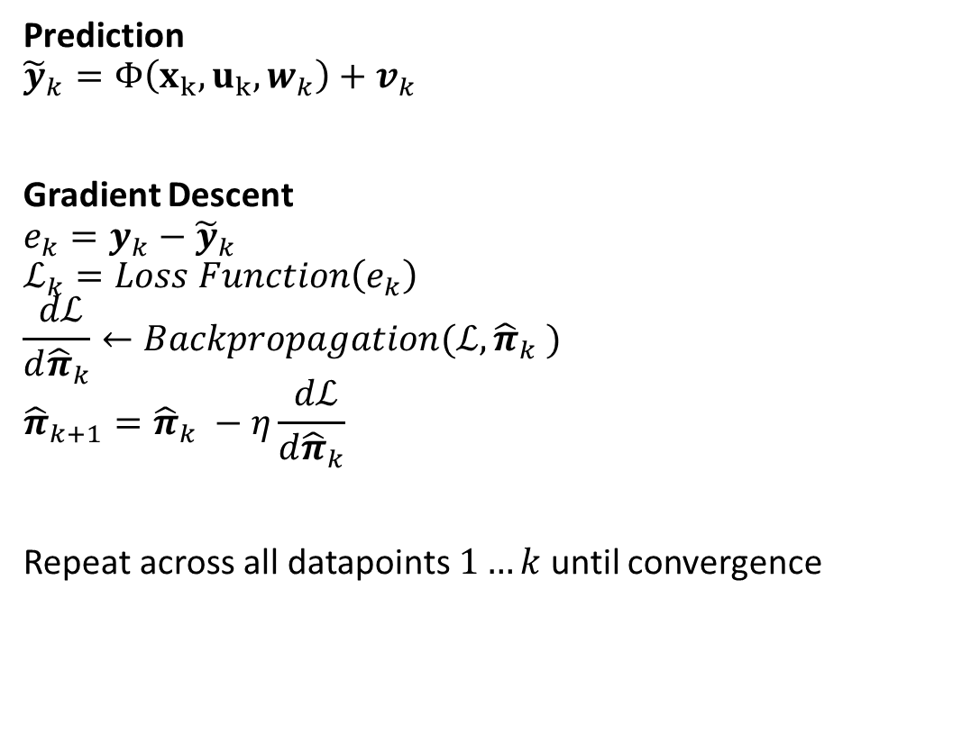
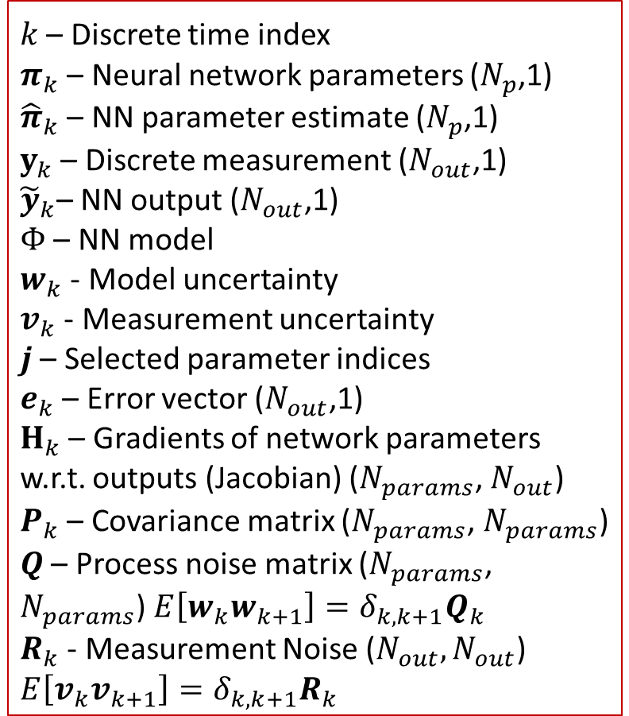
NN Training
Prediction
$${\tilde{y}}_{k}=Φ\left(x_{k},u_{k},w_{k}\right)+v_{k}$$
Gradient Descent
$$e_{k}=y_{k}−{\tilde{y}}_{k}$$
$$ℒ_{k}=Loss Function\left(e_{k}\right)$$
$$\frac{ dℒ}{d{\hat{π}}_{k}}←Backpropagation(ℒ,{\hat{π}}_{k} )$$
$${\hat{π}}_{k+1}={\hat{π}}_{k} −η\frac{ dℒ}{d{\hat{π}}_{k}}$$
Repeat across all datapoints $1…k$ until convergence
$k$ – Discrete time index
$π_{k}$ – Neural network parameters ($N_{p}$,1)
${\hat{π}}_{k}$ – NN parameter estimate ($N_{p}$,1)
$y_{k}$ – Discrete measurement ($N_{out}$,1)
${\tilde{y}}_{k}$– NN output ($N_{out}$,1)
$Φ$ – NN model
$w_{k}$ - Model uncertainty
$v_{k}$ - Measurement uncertainty
$j$ – Selected parameter indices
$e_{k}$ – Error vector ($N_{out}$,1)
$H_{k}$ – Gradients of network parameters w.r.t. outputs (Jacobian) ($N_{params}$, $N_{out}$)
$P_{k}$ – Covariance matrix ($N_{params}$, $N_{params}$)
$Q$ – Process noise matrix ($N_{params}$, $N_{params}$) $E\left[w_{k}w_{k+1}\right]=δ_{k,k+1}Q_{k}$
$R_{k}$ - Measurement Noise ($N_{out},N_{out}$) $E\left[v_{k}v_{k+1}\right]=δ_{k,k+1}R_{k}$
10
Notes:
During training, NN parameters are fitted by minimizing the difference between the model prediction (shown as y tilde) and the measurement y. Gradient descent algorithms use first-order information of how each parameter contributes to the loss function--calculated using backpropagation--to update the NN parameters.

Slide 11
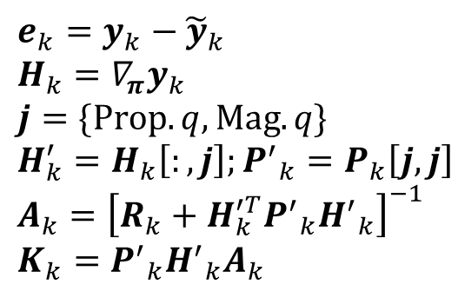
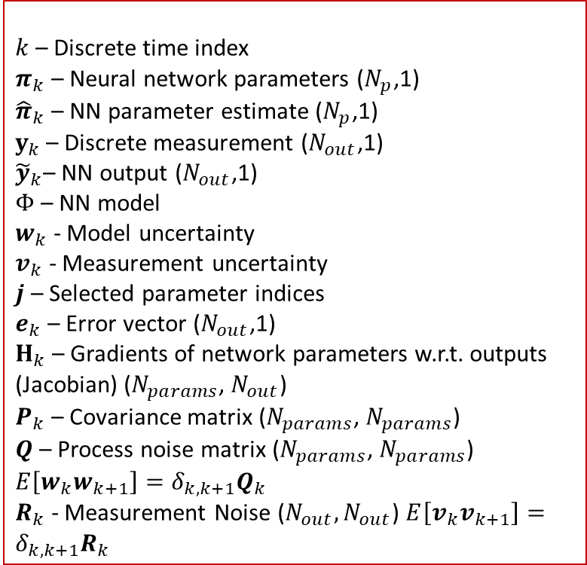
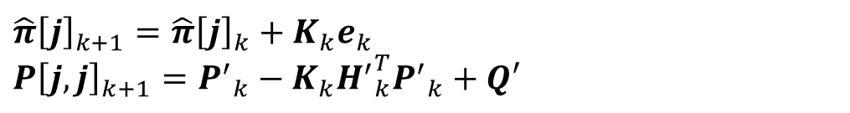
Strategies for updating NN models
Hammond et. al “Staying Alive: Online Neural Network Maintenance and Systemic Drift” arXiv:2503.17681
Idea: If models are similar, and their parameters will be close, we can use model-updating techniques to evolve model parameters to reflect the target system
The Subset Extended Kalman Filter (SEKF)
Uses well-established Kalman Filtering techniques to update a subset of model parameters
Probabilistic methods for state-estimation in the presence of noise ideally limit spurious correlations and overfitting
$k$ – Discrete time index
$π_{k}$ – Neural network parameters ($N_{p}$,1)
${\hat{π}}_{k}$ – NN parameter estimate ($N_{p}$,1)
$y_{k}$ – Discrete measurement ($N_{out}$,1)
${\tilde{y}}_{k}$– NN output ($N_{out}$,1)
$Φ$ – NN model
$w_{k}$ - Model uncertainty
$v_{k}$ - Measurement uncertainty
$j$ – Selected parameter indices
$e_{k}$ – Error vector ($N_{out}$,1)
$H_{k}$ – Gradients of network parameters w.r.t. outputs (Jacobian) ($N_{params}$, $N_{out}$)
$P_{k}$ – Covariance matrix ($N_{params}$, $N_{params}$)
$Q$ – Process noise matrix ($N_{params}$, $N_{params}$) $E\left[w_{k}w_{k+1}\right]=δ_{k,k+1}Q_{k}$
$R_{k}$ - Measurement Noise ($N_{out},N_{out}$) $E\left[v_{k}v_{k+1}\right]=δ_{k,k+1}R_{k}$
$$e_{k}=y_{k}−{\tilde{y}}_{k} \\ H_{k}=∇_{π}y_{k} \\ j=\{Prop.q, Mag.q\} \\ H_{k}^{′}=H_{k}\left[:,j\right];{P^{′}}_{k}=P_{k}\left[j,j\right] \\ A_{k}={\left[R_{k}+H_{k}^{′T}{P^{′}}_{k}{H^{′}}_{k}\right]}^{−1} \\ K_{k}={P^{′}}_{k}{H^{′}}_{k}A_{k}$$
Parameter selection
$${\hat{π}\left[j\right]}_{k+1}={\hat{π}\left[j\right]}_{k}+K_{k}e_{k} \\ {P\left[j,j\right]}_{k+1}={P^{′}}_{k}−K_{k}{H^{′}}_{k}^{T}{P^{′}}_{k}+Q′$$
11
Notes:
Since we believe that the NN model parameters of the source model will be close to the parameters of the target model, we can use model-updating techniques to evolve model parameters from the source parameters to the target parameters.
One such model-updating technique is the Subset Extended Kalman Filter which performs Extended Kalman Filter update steps to a subset of model parameters. This lowers the computational cost of Kalman Filtering while updating parameters using the second-order information available within the process noise and parameter covariance models.

Slide 12
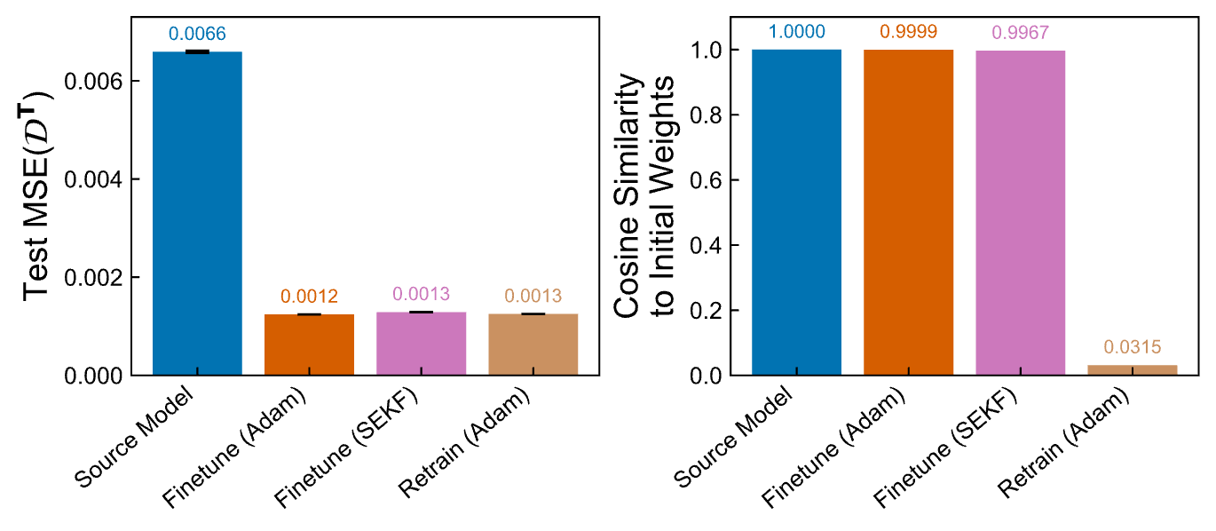
Transfer Learning for Damped Spring
$$m_{s}\ddot{x}+c_{s}\dot{x}+k_{s}x=u_{s}$$
Given:$x_{0},{\dot{x}}_{0}$
Predict: $x_{1},x_{2},…,x_{20}$
Competing Techniques:
Apply source model
Finetune (train NN starting from source model parameters) using Adam
Finetune using SEKF
Retrain (reinitialize NN weights) using ADAM
Use a 2-layer MLP
32 neurons each layer
Sigmoid activation
2,868 trainable parameters
Notes:
We will measure the generalization error of transfer learning techniques by evaluating prediction error on a large dataset from the target system that was withheld during transfer learning.
We will compare a control case of no modifications to the source model to finetuning and retraining. Finetuning begins with the source model weights and modifies them. In our case we use either Adam or the Subset Extended Kalman Filter. Retraining in contrast begins by randomly initializing the neural network parameters.

Slide 13
Transfer Learning for Damped Spring
$$m_{s}\ddot{x}+c_{s}\dot{x}+k_{s}x=u_{s}$$
Given:$x_{0},{\dot{x}}_{0}$
Predict: $x_{1},x_{2},…,x_{20}$
Competing Techniques:
Apply source model
Finetune (train NN starting from source model parameters) using Adam
Finetune using SEKF
Retrain (reinitialize NN weights) using ADAM
Preliminary findings
Finetuning results in similar model parameters between source and target
Retraining may change NN model parameters substantially
Loss is comparable
Notes:
The two bar plots on the bottom show the loss (on the left) and the cosine similarity of model parameters to the initial parameters for all 4 methods.
Both finetuning and retraining reduce the loss. However high cosine similarity of the finetuning methods indicates that the reduction in loss can be achieved with relatively few changes to the source model, which would require less manual work than retraining the model completely.

Slide 14
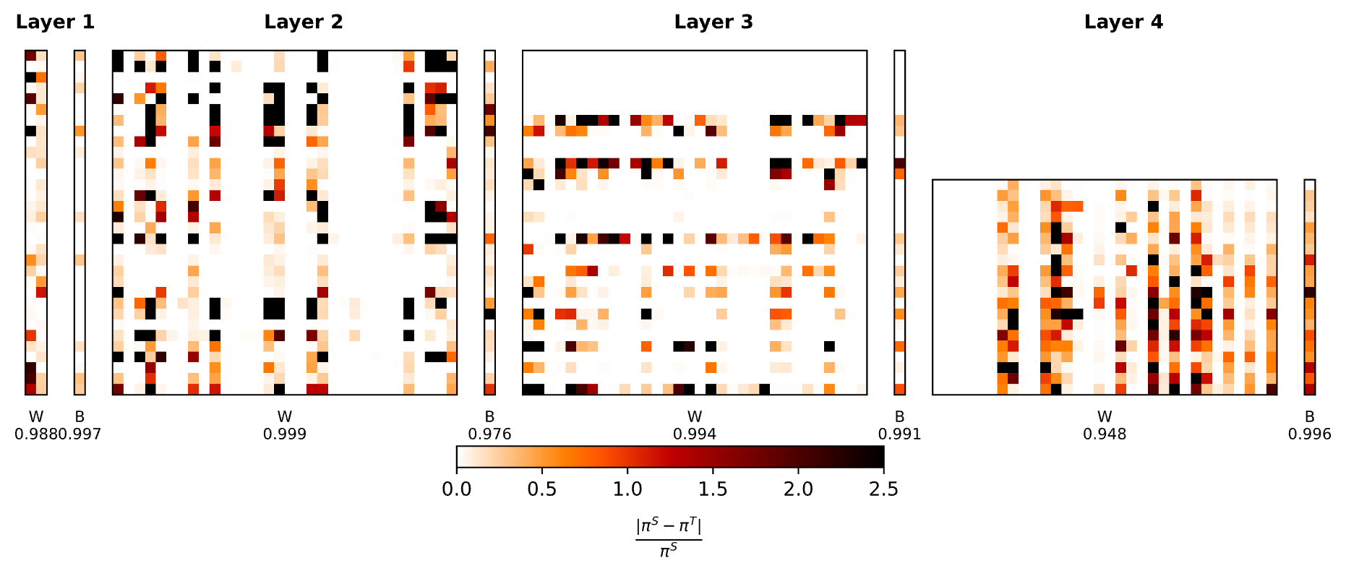
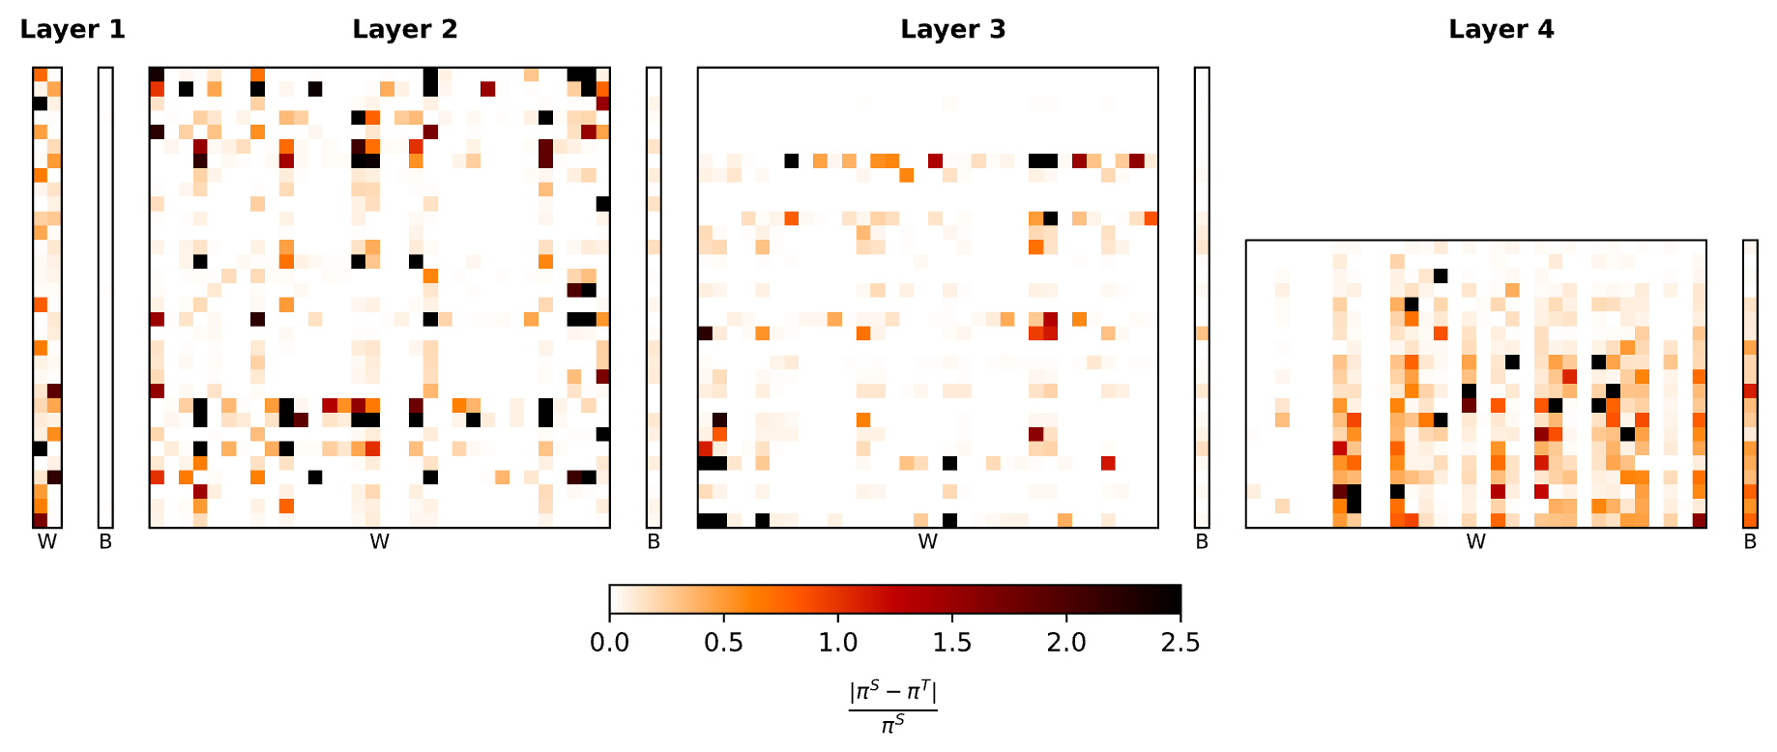
Changes to the NN parameters are distributed through the model
SEKF Weights
Adam Weights
Notes:
If we compare how the model weights evolve during finetuning, the changes are distributed through out the model for the models that use Adam and the SEKF.

Slide 15

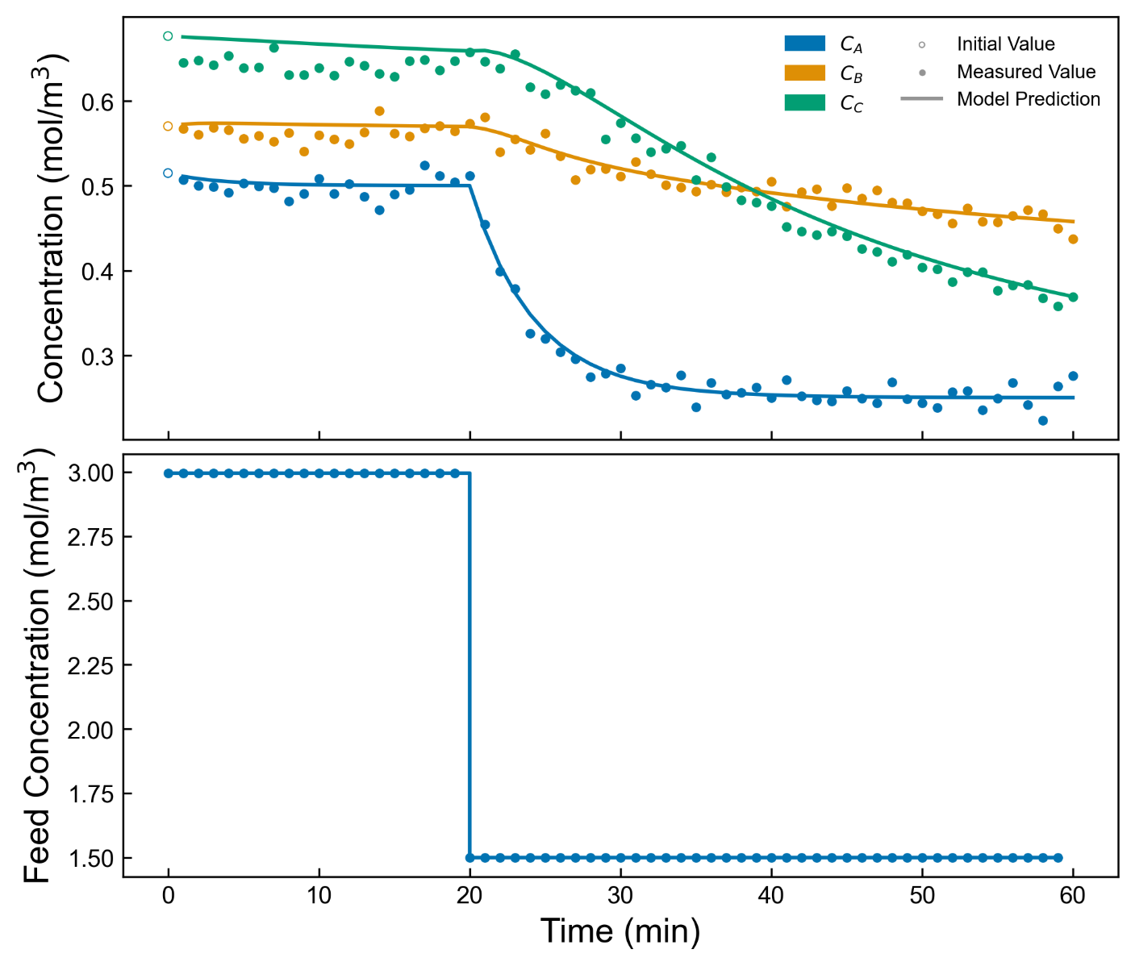
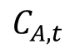
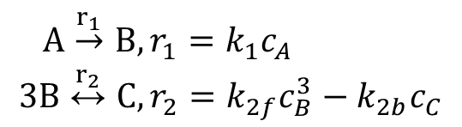
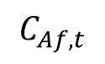
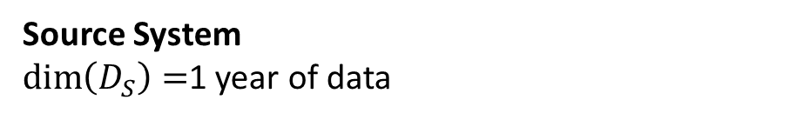
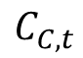
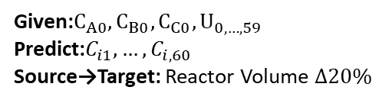
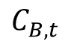
Example: Official TWCCC CSTR ☺
Given:$C_{A0},C_{B0},C_{C0},U_{0,…,59}$
Predict:$C_{i1},…,C_{i,60}$
Source→Target: Reactor Volume $Δ20\%$
$$\begin{aligned}A\overset{r_{1}}{→}B,&r_{1}=k_{1}c_{A} \\ 3B\overset{r_{2}}{↔}C,&r_{2}=k_{2f}c_{B}^{3}−k_{2b}c_{C}\end{aligned}$$
$$C_{Af,t}$$
$$C_{A,t}$$
$$C_{B,t}$$
$$C_{C,t}$$
Use a 2-layer Neural ODE
16 neurons each layer
Sigmoid activation
419 trainable params
Source System
$\dim\left(D_{S}\right)=$1 year of data
[1] Kumar, P., & Rawlings, J. B. (2023). Structured nonlinear process modeling using neural networks and application to economic optimization. Computers and Chemical Engineering, 177. https://doi.org/10.1016/j.compchemeng.2023.108314
Notes:
As a last example, we wouldn’t be chemical engineers if we didn’t have a CSTR example. The physical model is drawn from a 2023 Computers and Chemical Engineering publication from the Rawlings lab.
Given initial concentrations of all three species, and inlet concentrations over the prediction horizon, the model predicts outlet concentrations at each minute for the next hour.
*click*
We use a neural ODE architecture similar to that shown in the paper I mentioned, and trained the source model using 1 year of operating data.
The plot on the right shows the feed concentration at the top and the initial measurements in open circles on the left of the bottom plot. As time progresses from left to right, the measured data are shown with dots and the source model prediction is shown in solid lines.

Slide 16
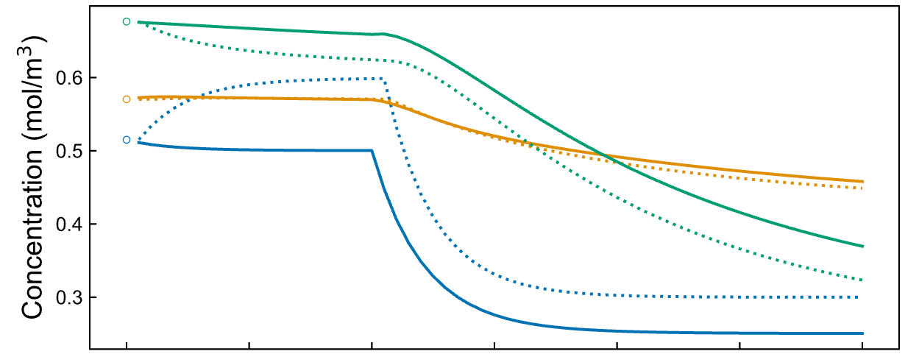
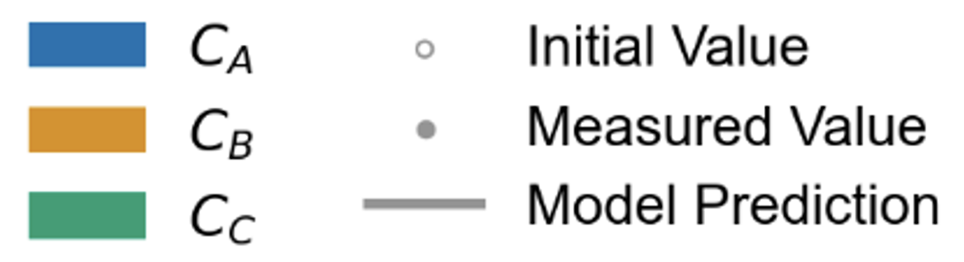
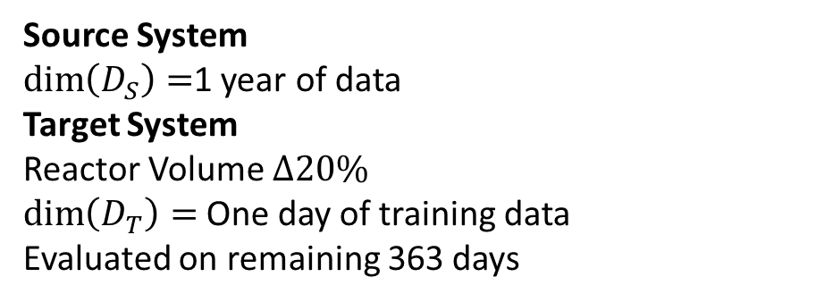
Example: Official TWCCC CSTR ☺
Given:$C_{A0},C_{B0},C_{C0},U_{0,…,59}$
Predict:$C_{i1},…,C_{i,60}$
Source→Target: Reactor Volume $Δ20\%$
$$\begin{aligned}A\overset{r_{1}}{→}B,&r_{1}=k_{1}c_{A} \\ 3B\overset{r_{2}}{↔}C,&r_{2}=k_{2f}c_{B}^{3}−k_{2b}c_{C}\end{aligned}$$
$$C_{Af,t}$$
$$C_{A,t}$$
$$C_{B,t}$$
$$C_{C,t}$$
Use a 2-layer Neural ODE
16 neurons each layer
Sigmoid activation
419 trainable params
Source System
$\dim\left(D_{S}\right)=$1 year of data
Target System
Reactor Volume $Δ20\%$
$\dim\left(D_{T}\right)=$One day of training data
Evaluated on remaining 363 days
[1] Kumar, P., & Rawlings, J. B. (2023). Structured nonlinear process modeling using neural networks and application to economic optimization. Computers and Chemical Engineering, 177. https://doi.org/10.1016/j.compchemeng.2023.108314
Notes:
As we move to the target system, we decrease the reactor volume by 20% from 15 cubic meters to 12. The effect of this change is shown on the right with the trajectories from the source system are shown with solid lines, and the trajectory from the target system given the same inputs is shown with the dashed lines.
We will perform transfer learning using 1 day of data from the target system (in contrast to the year that was available to train the source model). Then we simulate the rest of the year to evaluate the generalization error of the model

Slide 17
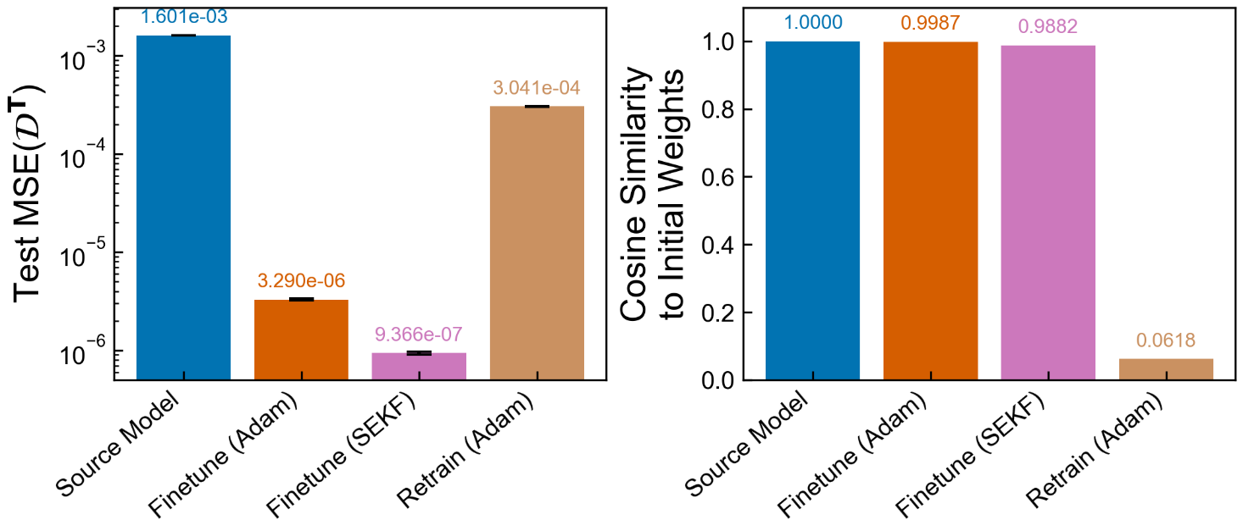
Example: Official TWCCC CSTR ☺
Given:$C_{A0},C_{B0},C_{C0},U_{0,…,59}$
Predict:$C_{i1},…,C_{i,60}$
Source→Target: Reactor Volume $Δ20\%$
$$\begin{aligned}A\overset{r_{1}}{→}B,&r_{1}=k_{1}c_{A} \\ 3B\overset{r_{2}}{↔}C,&r_{2}=k_{2f}c_{B}^{3}−k_{2b}c_{C}\end{aligned}$$
$$C_{Af,t}$$
$$C_{A,t}$$
$$C_{B,t}$$
$$C_{C,t}$$
Use a 2-layer Neural ODE
16 neurons each layer
Sigmoid activation
419 trainable params
Source System
$\dim\left(D_{S}\right)=$1 year of data
Target System
Reactor Volume $Δ20\%$
$\dim\left(D_{T}\right)=$One day of training data
Evaluated on remaining 363 days
[1] Kumar, P., & Rawlings, J. B. (2023). Structured nonlinear process modeling using neural networks and application to economic optimization. Computers and Chemical Engineering, 177. https://doi.org/10.1016/j.compchemeng.2023.108314
Notes:
As before, updating the parameters of the source model reduces error. Also similarly, the cosine similarity of the finetuned models is much higher than that of the retrained model.
In contrast to the spring system however, retraining the model results in about two orders of magnitude more error than finetuning. The difference between finetuning with the Adam optimizer and the SEKF is also distinctive here--likely due to the volume of data available from the target system

Slide 18
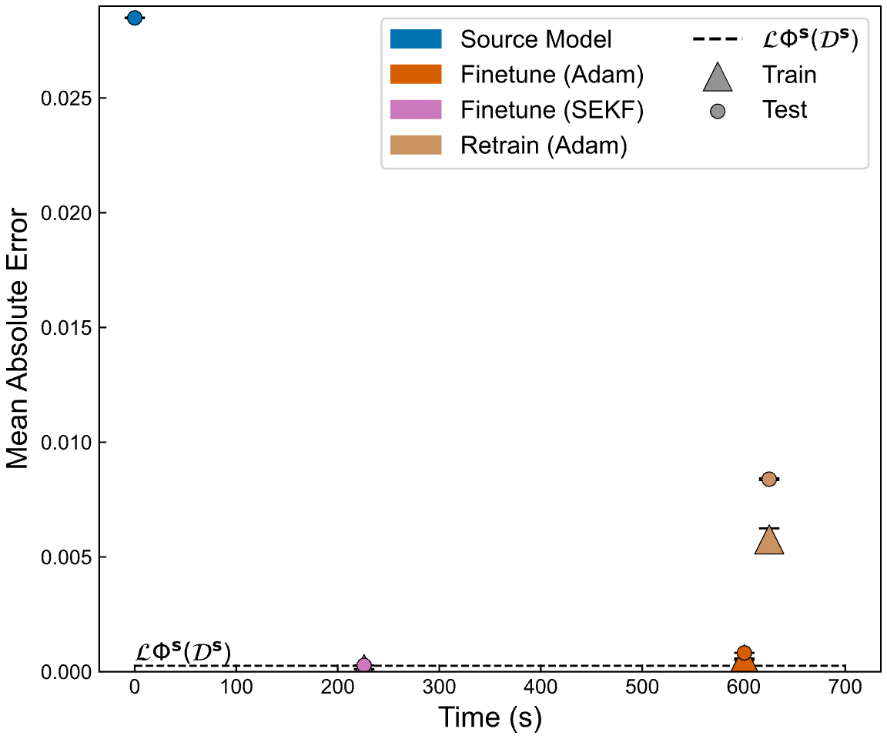
Example: Official TWCCC CSTR ☺
Given:$C_{A0},C_{B0},C_{C0},U_{0,…,59}$
Predict:$C_{i1},…,C_{i,60}$
Source→Target: Reactor Volume $Δ20\%$
$$\begin{aligned}A\overset{r_{1}}{→}B,&r_{1}=k_{1}c_{A} \\ 3B\overset{r_{2}}{↔}C,&r_{2}=k_{2f}c_{B}^{3}−k_{2b}c_{C}\end{aligned}$$
$$C_{Af,t}$$
$$C_{A,t}$$
$$C_{B,t}$$
$$C_{C,t}$$
Use a 2-layer Neural ODE
16 neurons each layer
Sigmoid activation
419 trainable params
Source System
$\dim\left(D_{S}\right)=$1 year of data
Target System
Reactor Volume $Δ20\%$
$\dim\left(D_{T}\right)=$One day of training data
Evaluated on remaining 363 days
[1] Kumar, P., & Rawlings, J. B. (2023). Structured nonlinear process modeling using neural networks and application to economic optimization. Computers and Chemical Engineering, 177. https://doi.org/10.1016/j.compchemeng.2023.108314
Notes:
If we look at these results in a different way, here we have the Mean Absolute Error shown vertically, and the time required to perform the transfer learning shown in seconds on the x axis. Along the bottom, the black dashed line is a reference of the Mean Absolute Error of the source model on the source data.
For each of the TL techniques compared, I have plotted the model prediction error from training data available during transfer learning with a triangle, as well as the error on the test dataset comprised of the rest of the year as a circle. In the top left is the error of the unchanged source model on the target dataset. Intuitively keeping the model the same does not require any time. Moving from left to right, finetuning with the SEKF requires just over 200 seconds and achieves lower MAE than even the source model did on the source dataset. Finetuning with Adam approaches the source loss but does not reach it, and requires more time than the SEKF. Finally, retraining takes more time yet and results in higher error.
The danger of small datasets--such as those often present when performing transfer learning--is that models may produce spurious correlations from the limited data, or in plain terms: overfit. We generally measure this by looking for a gap between the training loss shown as a triangle and the loss on the unseen test data shown as a circle. The training and test losses for the SEKF model are within statistical deviance of one another. However that gap increases for the model finetuned using Adam, and is even more dramatic for the retrained model.
One possible explanation for the dimminished overfitting when finetuning using the SEKF is the measurement noise and parameter covariance models used for the updates which may help reduce overfitting to noise.

Slide 19
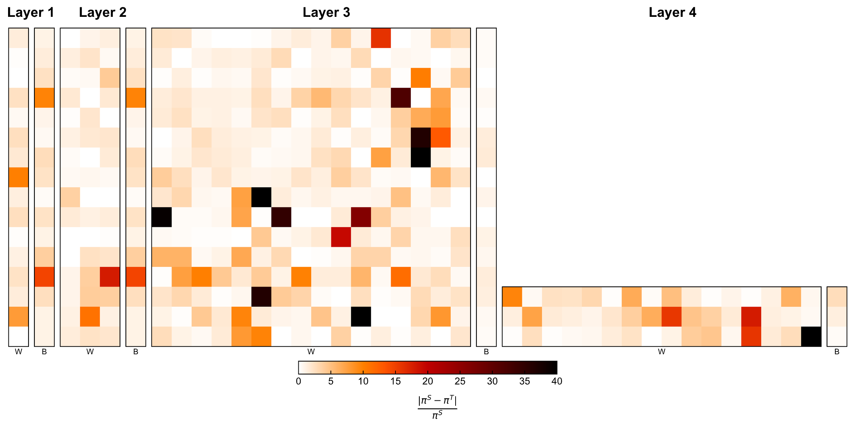
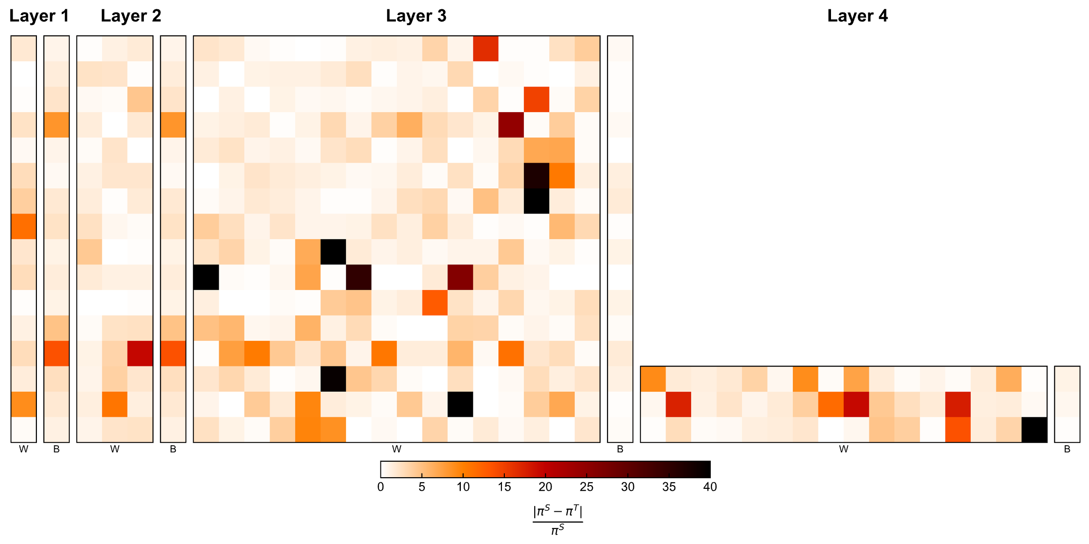
Changes to the NN parameters are distributed through the model
SEKF Weights
Similar but not identical
Adam Weights
Notes:
Again, if we compare the changes in the models when performing transfer learning, I'm impressed by how similar the changes are within the two models. I did about an hour of work verifying that I wasn't looking at the same model twice. Yet, small changes differences in the parameters result in a sizable difference in the loss of the two models

Slide 20
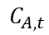
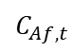
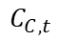
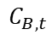
Small Changes in NN Parameters Adapt the Model (Source $→$ Target)
Identical processes vary in behavior.
Transfer Learning is most common in image processing. Determining which parameters to modify for dynamical regression is an open question.
Small changes in the source model parameters can adapt the model to the target system.
The SEKF may reduce the generalization error associated with the limited target dataset
$$C_{Af,t}$$
$$C_{A,t}$$
$$C_{B,t}$$
$$C_{C,t}$$
Notes:
I want to end by recontextualizing what we've talked about:
Even identically designed processes behave differently. Data-driven models then need to be derived on data from that specific process they are modeling which becomes labor and data intensive.
Transfer Learning is most common in image processing where the common approach is to retrain the last few layers of the neural network. Determining which parameters to modify in dynamical regression is not established in the literature
Finally small changes to the source model parameters can adapt the model to the target system. In addition, the SEKF may reduce the generalization error associated with the limited target dataset.

Slide 21
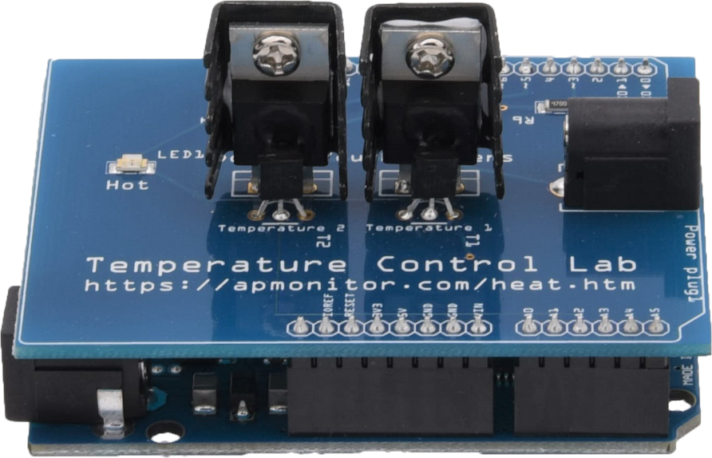
Future Work
Accuracy
Data
Notes:
Future work will look to further empirically evaluate these claims.
I'll be evaluating how model accuracy changes with the ammount of data available from the target system in the systems I've discussed.
In addition, I am currently adapting the source model of a simulated system to data drawn from the real system using the Temperature control lab that many here have worked with.

Slide 22
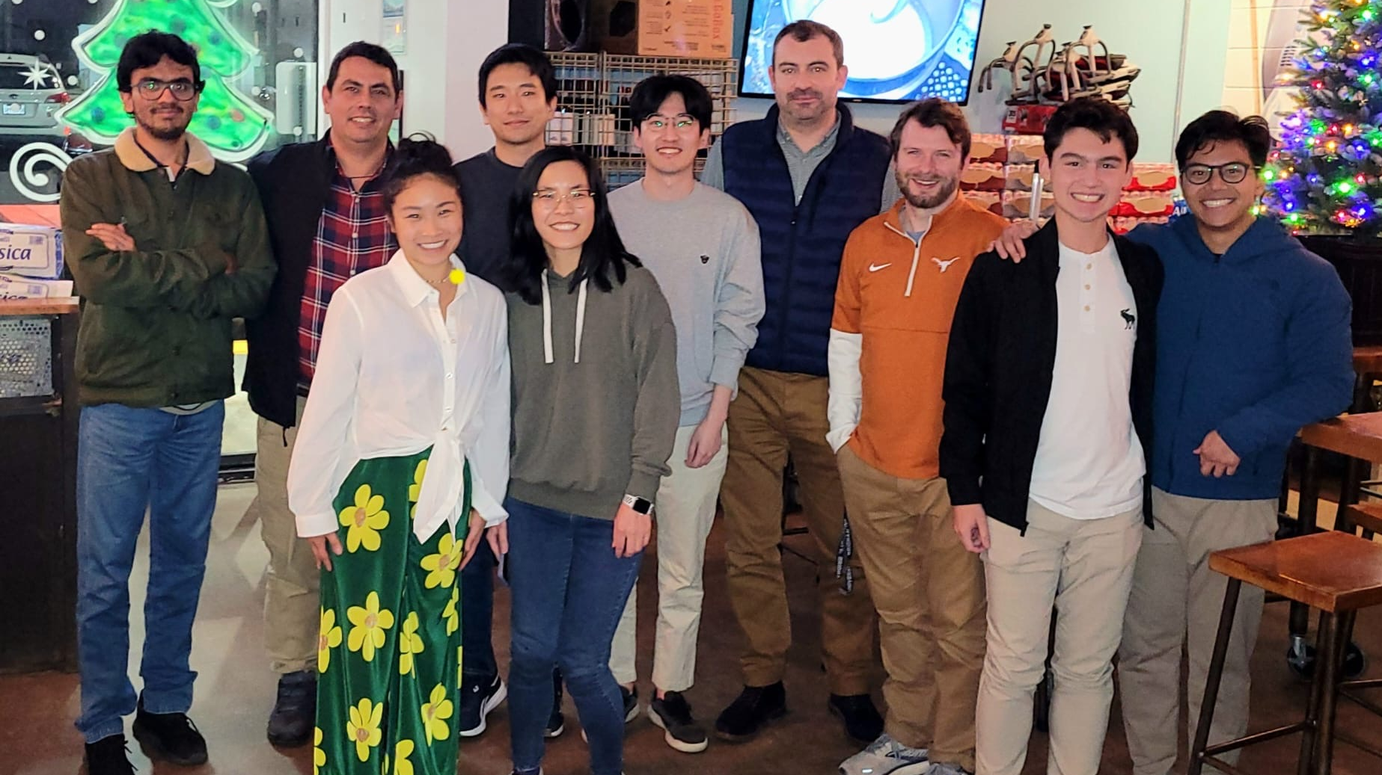

Thank you
Baldea Group
Korgel Group
Thank you to Tyler Soderstrom and ExxonMobil for the support
Notes:
As I close, I’d like to acknowledge the feedback and guidance from both of my advisors and lab groups, as well as again Tyler Soderstrom and Exxon

Slide 23
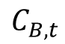



Questions?
$$C_{Af,t}$$
$$C_{A,t}$$
$$C_{B,t}$$
$$C_{C,t}$$
joshua.hammond@utexas.edu
Notes:
Thank you for your attention, I'd be happy to take any questions you have at this time.

Slide 24
Supplemental Slides

Slide 25

Damped Spring System: Source Model Training Details
Training Data
100,000 Examples:
10,000 for training
10,000 for validation
80,000 for testing
$x_{0},{\dot{x}}_{0}$ for each examples drawn from uniform distribution [-5,5]
AHSA Hyperparameter Tuning w/ 100 samples
Max 200 Epochs
Hyperparameters
Batch size (16, 32, 64, 128, 256, 1028, 4096)
Decrease LR on Plateau Scheduler
Initial learning rate ($1×{10}^{−6}$ - $1×{10}^{−1}$)
Learning rate patience(10, 20, 30, 40, 50)
Learning rate factor (0.1 - 0.9)
Best Model:
Batch Size: 16
Initial learning rate: 0.03182
Patience: 10 epochs
LR factor: 0.3442

Slide 26

Damped Spring System: Transfer Learning Details
Training Data
100,000 Examples:
10,000 for training
10,000 for validation
80,000 for testing
$x_{0},{\dot{x}}_{0}$ for each examples drawn from uniform distribution [-5,5]
AHSA Hyperparameter Tuning w/ 100 samples
Max 200 Epochs
Hyperparameters
Batch size (16, 32, 64, 128, 256, 1028, 4096)
Decrease LR on Plateau Scheduler
Initial learning rate ($1×{10}^{−6}$ - $1×{10}^{−1}$)
Learning rate patience(10, 20, 30, 40, 50)
Learning rate factor (0.1 - 0.9)
Best SEKF Parameters:
Batch Size: 32
Initial learning rate: 100
Patience: 100 epochs
LR factor: -
Q = $1×{10}^{−6}$ $I$
Initial P = 100 $I$
% parameters updated: 54.5 %

Slide 27

Damped Spring System: Full Results

Slide 28





CSTR System: Initial Training Details
Predicted States ${\hat{X}}_{1…n_{p}}$
Training Data
1 Year of data
80% for training
10% for validation
10% for testing
5 minute interval between each input-output example to maximize throughput while minimizing redundant information
Hyperparameters
Epochs: 10
Learning Rate: 0.1
Batch Size: 256
Runge-Kutta
$$d\hat{X}/dt$$
$${\hat{X}}_{i+1}$$
Linear (46)
Sigmoid
Linear (64)
Sigmoid
Linear (64)
States $X_{0}$(31)
Concatenate
Input $U_{i}$(15)

Slide 29











Multi-stream SEKF
Problem: The SEKF performs updates on single datapoints. When performing this across large datasets, this becomes time-consuming to iterate across all datapoints individually.
For a batch size $b$, where each prediction includes $o$ outputs produced from a model with $p$ parameters:
Standard Batched Operations
Individual losses averaged into a single scalar value
Update calculated with respect to that single averaged loss
Multi-Stream Operations
Individual losses and Jacobians concatenated
Update is the sum of each individual update calculated in parallel
$$e_{ob,1}=y_{ob,1}−{\tilde{y}}_{ob,1} \\ H_{ob,p}=∇_{π}y_{ob,1} \\ A_{ob,ob}={\left[R_{ob,ob}+H_{ob,p}P_{p,p}{H^{T}}_{p,ob}\right]}^{−1} \\ K_{p,ob}=P_{p,p}{H^{T}}_{p,ob}A_{ob,ob} \\ {\hat{π}}_{p,1}={\hat{π}}_{p,1}+K_{p,ob}e_{ob,1} \\ P_{p,p}=P_{p,p}−K_{p,ob}H_{ob,p}P_{k}+Q_{p,p}$$
Data Pairs
Error Vector
Jacobian Matrix
$$(x_{0},u)$$
$$\hat{y}$$
$$1$$
$$p$$
$$1$$
$$…$$
$$ob$$
$$ob$$
$$b$$

Slide 30


Hot topic: neural networks in Process Systems Engineering
Data science, machine learning, and artificial intelligence research and tools have been increasing at an exponential rate.
Neural networks have been the “hot topic”
Most research assumes that there is sufficient data coverage and quantity, that the training data is drawn from the same system as the application, and that the system is stationary
Data-driven models have no generalization or extrapolation guarantees
Web of Science Query Topic: “Neural Network” Dates: 2010 – 2025 Journals: Computers & Chemical Engineering, Industrial & Engineering Chemistry, Scientific Reports, Renewable Sustainable Energy Reviews, Journal of Process Control, Chemical Engineering Science, Chemical Engineering Research Design, AICHE Journal
Notes:
Artificial intelligence and Machine Learning have have shown promise to extract meaning and information from data. In the last decade, there has been an explosion of research, funding, and business hype especially as of late with large language models.
Neural Network models have been used to as universal function approximators due to their ability to model functions to arbitrary accuracy given enough data. This data requirement is non-trivial, especially as the number of parameters within the model increases. Much of the research available in our field assumes that sufficient data is available, it accurately reflects the data the model will be evaluated on, and that that data covers all possible phenomena.
These assumptions are not representative of realistic use-cases for NN models in process systems engineering.
In addition, data-driven models have no guarantee of generalization outside the data available during initial training and validation

Slide 31

How do we measure the similarity of two black-box systems?
Hypothesis: Given that the two systems are similar
The parameter space of the target model is close to the parameter space of the source model
A path exists from the source model parameters to the target model parameters
Data Similarity
Measures such as the Kolomogorov-Smirnov Test and Wasserstein Distance compare the distributions $p(u)$, $p(x)$
Functional Similarity
Given the same inputs
Dynamic Time Warping
Cosine Similarity
Mutual Information
Given only observational data
Granger Causality similarity
Surrogate model similarity
Linear model
Transfer function similarity
Hammerstein-Weiner model
Representational Similarity
Centered Kernel Alignment (CKA)
Cosine Similarity of encoder embedding
Perturbation sensitivity
Gradient Similarity
Topological similarity
Manifold Alignment

Slide 32







Can we transfer knowledge from the source to a new target?
Source System ($S$)
General Model
Transfer Learning
Target Model
Why use Transfer Learning?
Generalize rather than overfit to limited data from target system
Target System ($T$)
Challenges of Transfer Learning?
Determining similarity of domains, systems
Which model parameters to modify, how to modify them
$${dim(𝒟}_{T})≪{dim(𝒟}_{S})$$

Slide 33

When will transfer learning work?
Source System(s)
General Model
Transfer Learning
Target Model
Tasks are similar
How do we quantify this similarity?
Target System
Systems are similar
$${dim(𝒟}_{T})≪{dim(𝒟}_{S})$$

Slide 34

Example: TCLab Sim2Real
Given:$X_{0},U_{0,…,59}$
Predict:$X_{1},…,X_{60}$
Source→Target: Simulated to real
Equations here
Source System
1 year of simulated measurements
Target System
30 hours of real measurements
One day of training data, evaluated on 363 days
Use a 2-layer Neural ODE
16 neurons each layer
Sigmoid activation
419 trainable parameters
[1] Kumar, P., & Rawlings, J. B. (2023). Structured nonlinear process modeling using neural networks and application to economic optimization. Computers and Chemical Engineering, 177. https://doi.org/10.1016/j.compchemeng.2023.108314

Slide 35

Example: TCLab Sim2Real
Given:$X_{0},U_{0,…,59}$
Predict:$X_{1},…,X_{60}$
Source→Target: Simulated to real
Source System
1 year of simulated measurements
Target System
30 hours of real measurements
One day of training data, evaluated on 363 days
[1] Kumar, P., & Rawlings, J. B. (2023). Structured nonlinear process modeling using neural networks and application to economic optimization. Computers and Chemical Engineering, 177. https://doi.org/10.1016/j.compchemeng.2023.108314

Slide 36

Example: TCLab Sim2Real
Given:$X_{0},U_{0,…,59}$
Predict:$X_{1},…,X_{60}$
Source→Target: Simulated to real
Comparison of Source and Target
Source System
1 year of simulated measurements
Target System
30 hours of real measurements
One day of training data, evaluated on 363 days
[1] Kumar, P., & Rawlings, J. B. (2023). Structured nonlinear process modeling using neural networks and application to economic optimization. Computers and Chemical Engineering, 177. https://doi.org/10.1016/j.compchemeng.2023.108314

Slide 37

Example: TCLab Sim2Real
Given:$X_{0},U_{0,…,59}$
Predict:$X_{1},…,X_{60}$
Source→Target: Simulated to real
Source System
1 year of simulated measurements
Target System
30 hours of real measurements
One day of training data, evaluated on 363 days
[1] Kumar, P., & Rawlings, J. B. (2023). Structured nonlinear process modeling using neural networks and application to economic optimization. Computers and Chemical Engineering, 177. https://doi.org/10.1016/j.compchemeng.2023.108314

